Slide 1
An Introduction to the Multichannel Rendezvous Problem-Part IV
Prof. Cheng-Shang Chang (張正尚教授)
Institute of Communications Engineering National Tsing Hua University
July 2025

Slide 2
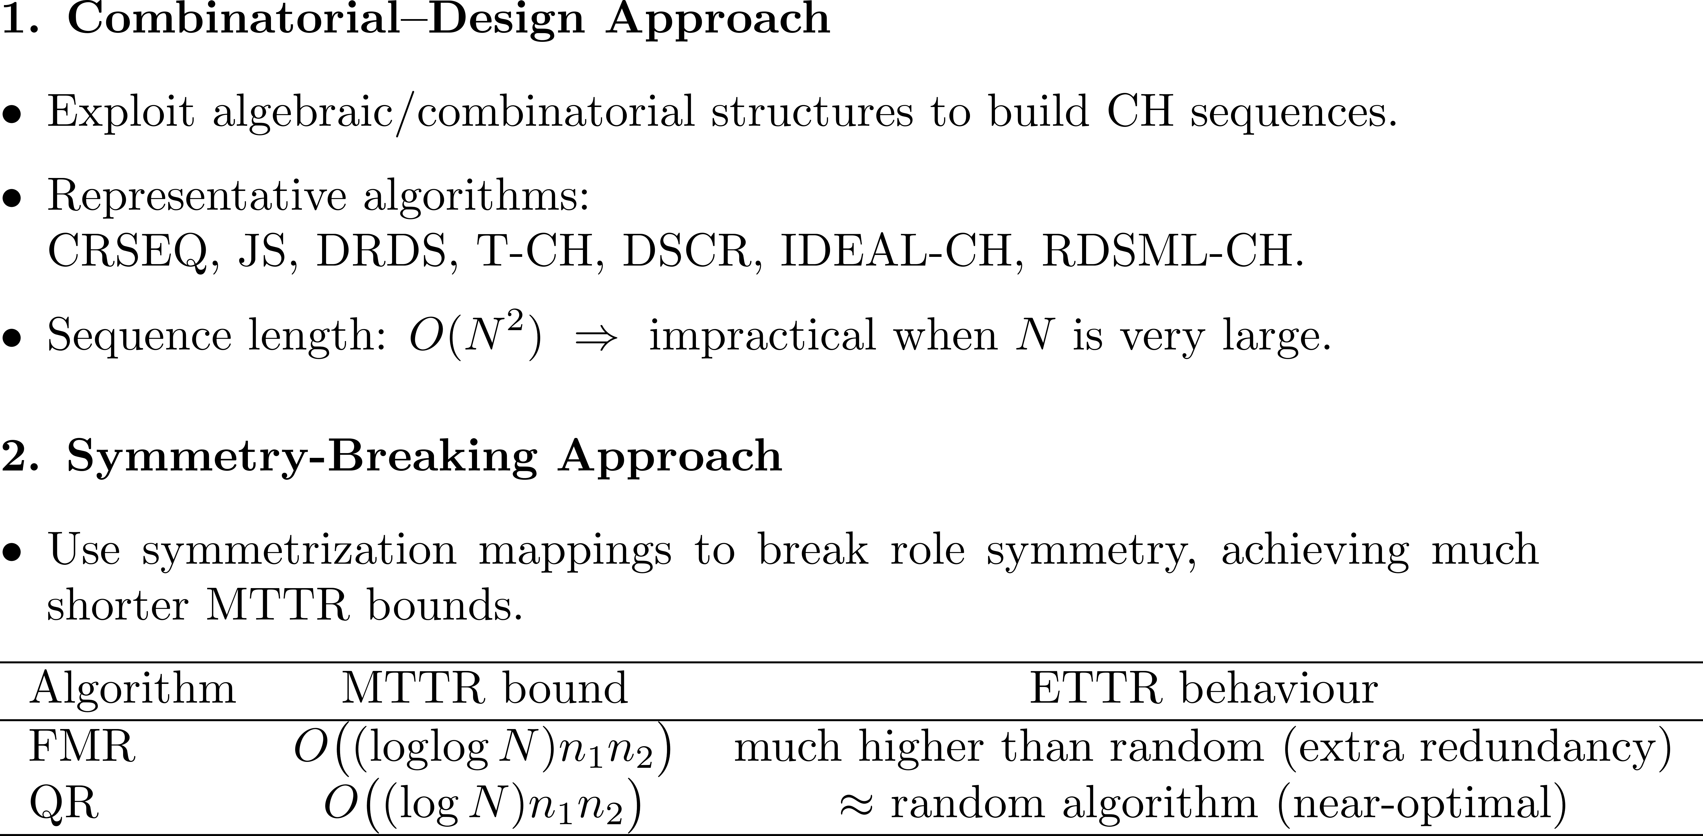
The sym/async/hetero/global MRP

Slide 3
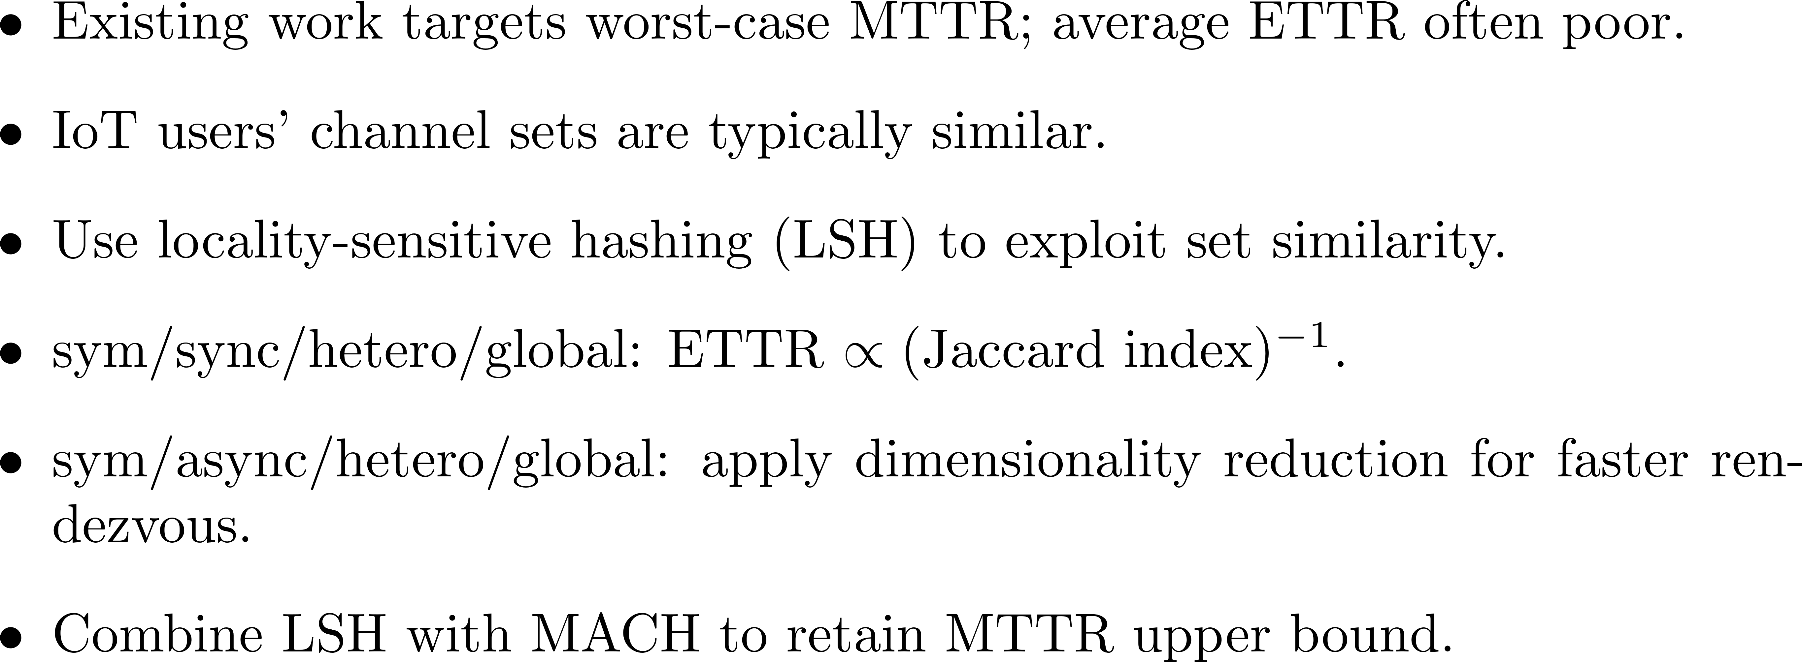
Can we beat the random algorithm in terms of ETTR?
G.-Y. Jiang and C.-S. Chang, ``Locality-sensitive hashing for efficient
rendezvous search: A new approach,‘’ IEEE Transactions on
Communications, vol. 72, no. 9, pp. 5674--5687, 2024.

Slide 4
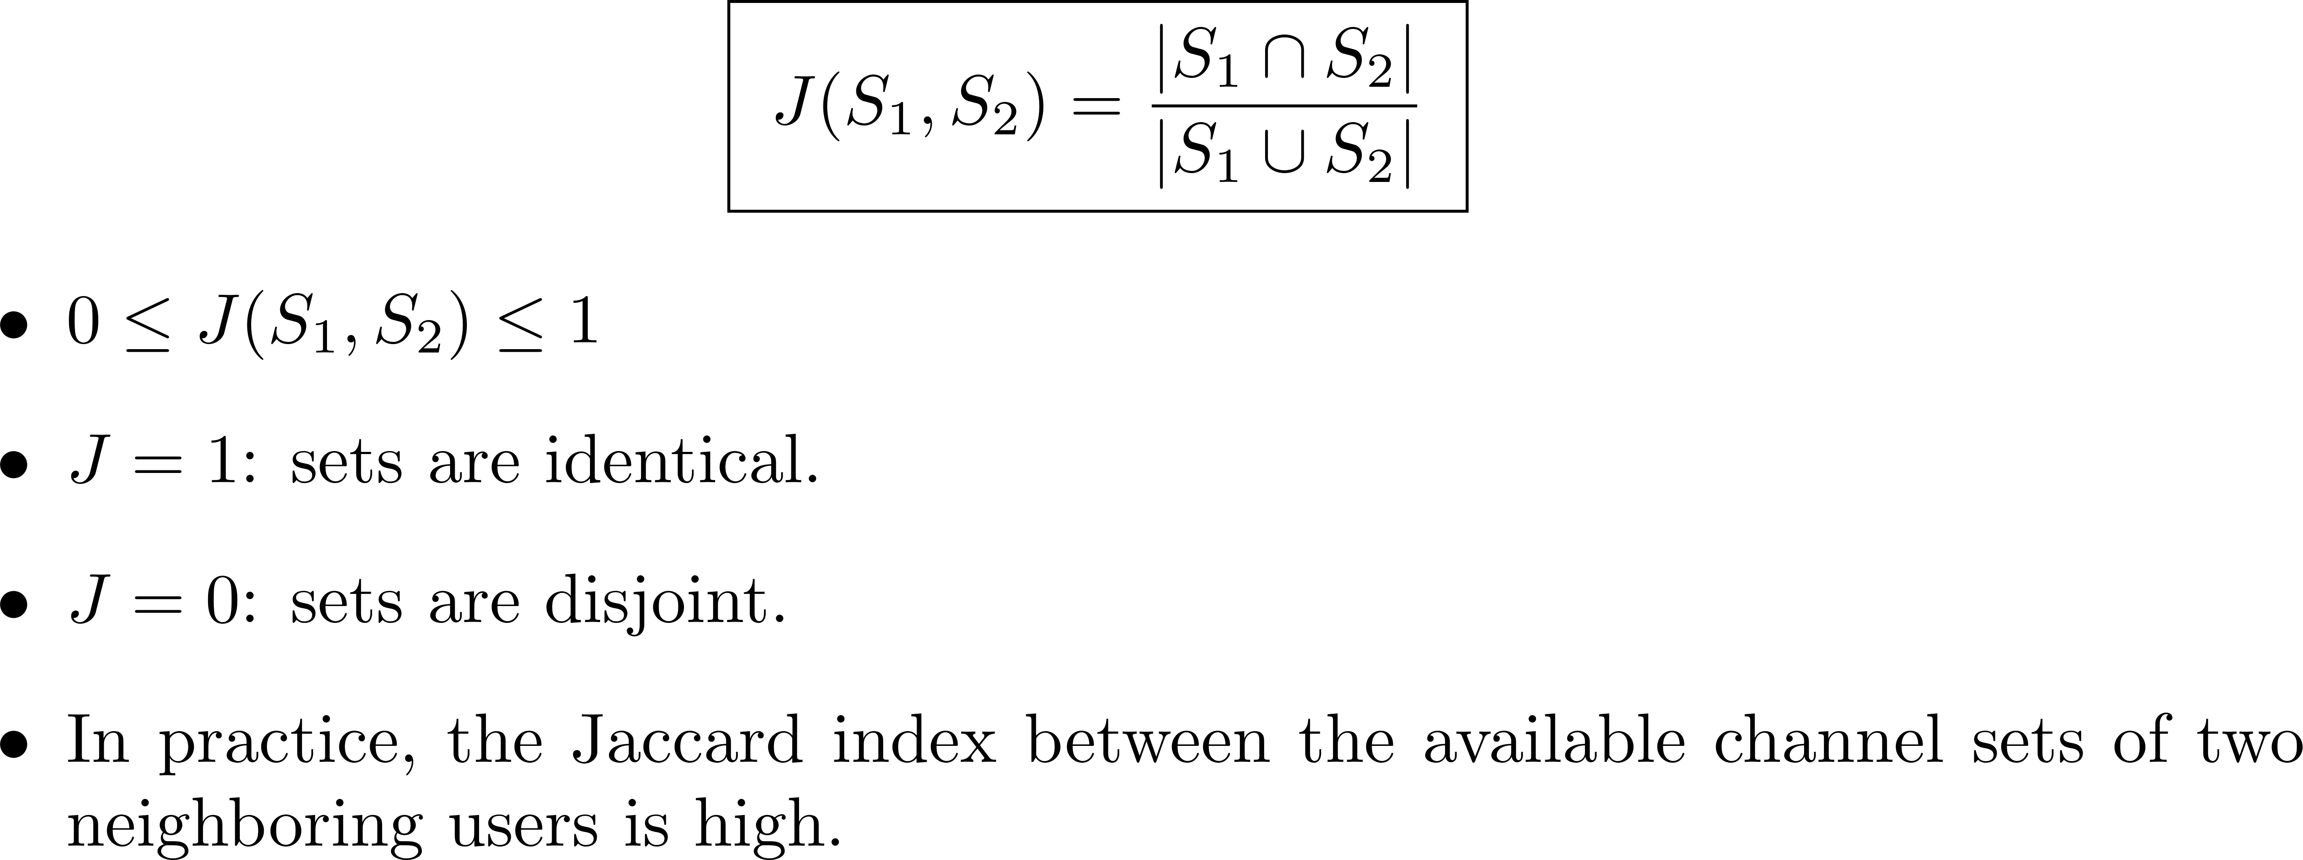
Jaccard index: measuring set similarity

Slide 5

Locality-sensitive hashing
(Data mining) Efficiently search similar objects in a large dataset by only comparing the hash values.
Each object is represented by an N-dim binary feature vector.
Generate a set of K hash functions that are uniformly distributed in [0, N − 1].
For each hash function, it returns the index to the first nonzero element of a binary feature vector (in the modulo manner).
The probability that two binary vectors have the same hash value is the Jaccard Index between the two binary vectors.
Notes:
LSH是一個用在data mining 很常用的技巧，主要就是用在hash相似的item，我們會先產生一個k個 hash function的set，他uniform的分佈在0到N-1之間，然後每個hash function都會回傳最近的nonzero element的index，讓資料達到降維的效果 比較好比較，這邊可以定義一個jaccard index，就是兩個set的連集分之交集
I’ll introduce locality sensitive hashing first. LSH is a very common technique used in data mining. By using this technique, we can efficiently search similar objects in a large dataset by only comparing the hash values. we generate a set of K hash functions that are uniformly distributed in [0, N − 1]
For each hash function, it returns the index of the first nonzero element of a binary vector in the modulo manner.
Here we can define Jaccard index, which is two sets Intersection over two sets union

Slide 6
Locality-sensitive hashing
2
Key:
K=3
0 | 1 | 0 | 0 | 1 | 0 | 0 | 0 | 1 | 0 | 0 | 0 | 1 | 0 | 0 | 0 | 1 | 0 | 0 | 0
0
Data:
0 | 0 | 1 | 0 | 1 | 0 | 0 | 0 | 0 | 1 | 0 | 0 | 1 | 0 | 0 | 1 | 0 | 0 | 0 | 0
1
0 | 0 | 1 | 0 | 0 | 1 | 0 | 0 | 0 | 0 | 1 | 0 | 0 | 1 | 0 | 0 | 1 | 0 | 0 | 0
1
0 | 1 | 0 | 1 | 0 | 0 | 0 | 0 | 0 | 1 | 0 | 0 | 1 | 0 | 0 | 0 | 1 | 0 | 0 | 0
0
0 | 0 | 1 | 0 | 1 | 0 | 0 | 0 | 0 | 1 | 0 | 0 | 1 | 0 | 0 | 0 | 1 | 0 | 0 | 0
1
Uniformly choose an index and find the nearest nonzero element and record its position
to the bucket
Notes:
接下來我會介紹一下locality sensitive hashing這個技巧，我們想要在很大的dataset裡面找到一個跟key很像的vector
它們都是二進制數字。局部敏感哈希將uniform的選擇一個element，並找到最接近的「1」並將其位置記錄下來。以這張圖片為例，首先選擇的是藍色的element。然後，該算法會將靠近藍色element的第一個非零元素的位置記錄下來。我們將該數字記錄到bucket中。
I’ll show the process of locality sensitive hashing first. There will be key and data, they are all binary numbers, and the Locality sensitive hashing will uniformly choose a frame and find the nearest 1 and record it. Take this picture as an example. The first place to cut is the blue frame. And this algorithm record the position of the first nonzero element near the blue frame as the diagram shown. We record the number to the bucket.

Slide 7
Locality-sensitive hashing
12
Key:
K=3
0 | 1 | 0 | 0 | 1 | 0 | 0 | 0 | 1 | 0 | 0 | 0 | 1 | 0 | 0 | 0 | 1 | 0 | 0 | 0
0 | 1
Data:
0 | 0 | 1 | 0 | 1 | 0 | 0 | 0 | 0 | 1 | 0 | 0 | 1 | 0 | 0 | 1 | 0 | 0 | 0 | 0
1 | 1
0 | 0 | 1 | 0 | 0 | 1 | 0 | 0 | 0 | 0 | 1 | 0 | 0 | 1 | 0 | 0 | 1 | 0 | 0 | 0
1 | 2
0 | 1 | 0 | 1 | 0 | 0 | 0 | 0 | 0 | 1 | 0 | 0 | 1 | 0 | 0 | 0 | 1 | 0 | 0 | 0
0 | 1
0 | 0 | 1 | 0 | 1 | 0 | 0 | 0 | 0 | 1 | 0 | 0 | 1 | 0 | 0 | 0 | 1 | 0 | 0 | 0
1 | 1
Uniformly choose an index and find the nearest nonzero element and record its position
to the bucket
Notes:
接下來也是一樣的過程，選橘色的element然後紀錄最近的1的位子到bucket裡面
Follow the same process, we choose orange frame and record the position of the first nonzero element to the bucket

Slide 8
Locality-sensitive hashing
15
Key:
K=3
0 | 1 | 0 | 0 | 1 | 0 | 0 | 0 | 1 | 0 | 0 | 0 | 1 | 0 | 0 | 0 | 1 | 0 | 0 | 0
0 | 1 | 2
Data:
0 | 0 | 1 | 0 | 1 | 0 | 0 | 0 | 0 | 1 | 0 | 0 | 1 | 0 | 0 | 1 | 0 | 0 | 0 | 0
1 | 1 | 1
0 | 0 | 1 | 0 | 0 | 1 | 0 | 0 | 0 | 0 | 1 | 0 | 0 | 1 | 0 | 0 | 1 | 0 | 0 | 0
1 | 2 | 2
similar
0 | 1 | 0 | 1 | 0 | 0 | 0 | 0 | 0 | 1 | 0 | 0 | 1 | 0 | 0 | 0 | 1 | 0 | 0 | 0
0 | 1 | 2
0 | 0 | 1 | 0 | 1 | 0 | 0 | 0 | 0 | 1 | 0 | 0 | 1 | 0 | 0 | 0 | 1 | 0 | 0 | 0
1 | 1 | 2
Uniformly choose an index and find the nearest nonzero element and record its position
to the bucket
Notes:
接下來選擇粉紅色的element然後record最近的1的位子到bucket裡面，這樣一來我們就可以比較bucket裡面降維之後的結果來找到similar的vector。
Then we choose pink frame and record the position of the first nonzero element to the bucket
Next we can compare the buckets and find out which data is similar to key.

Slide 9
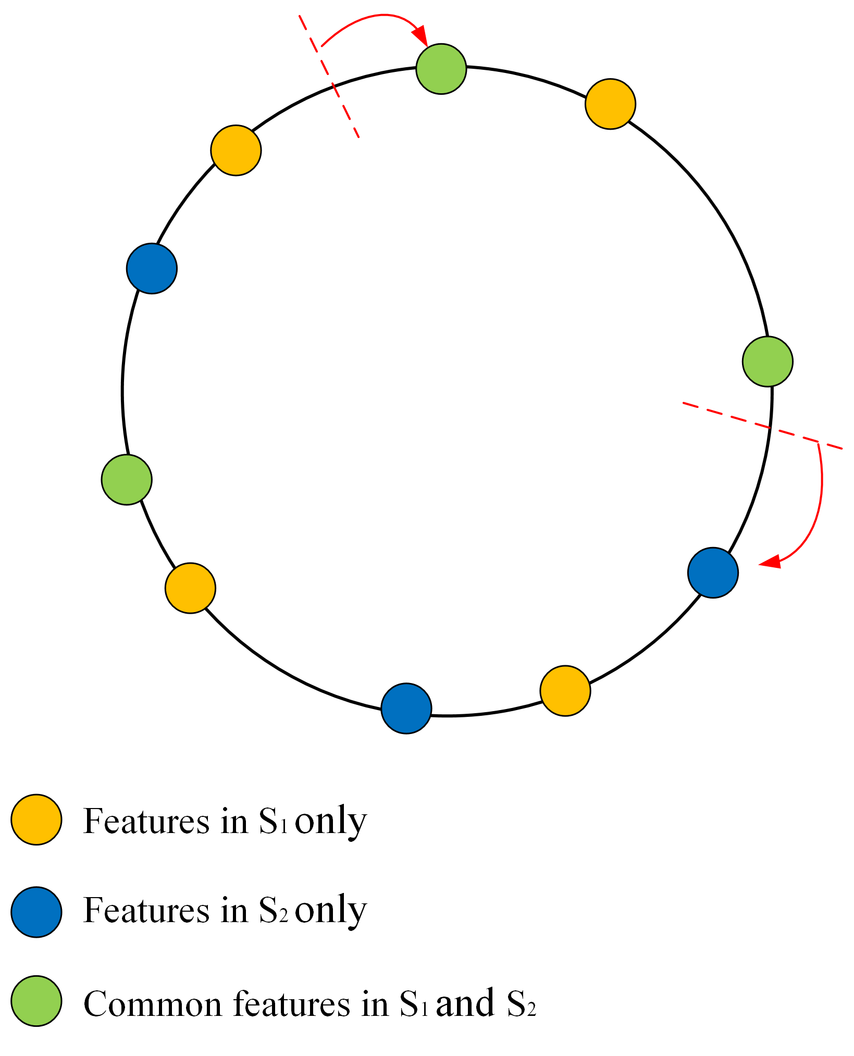
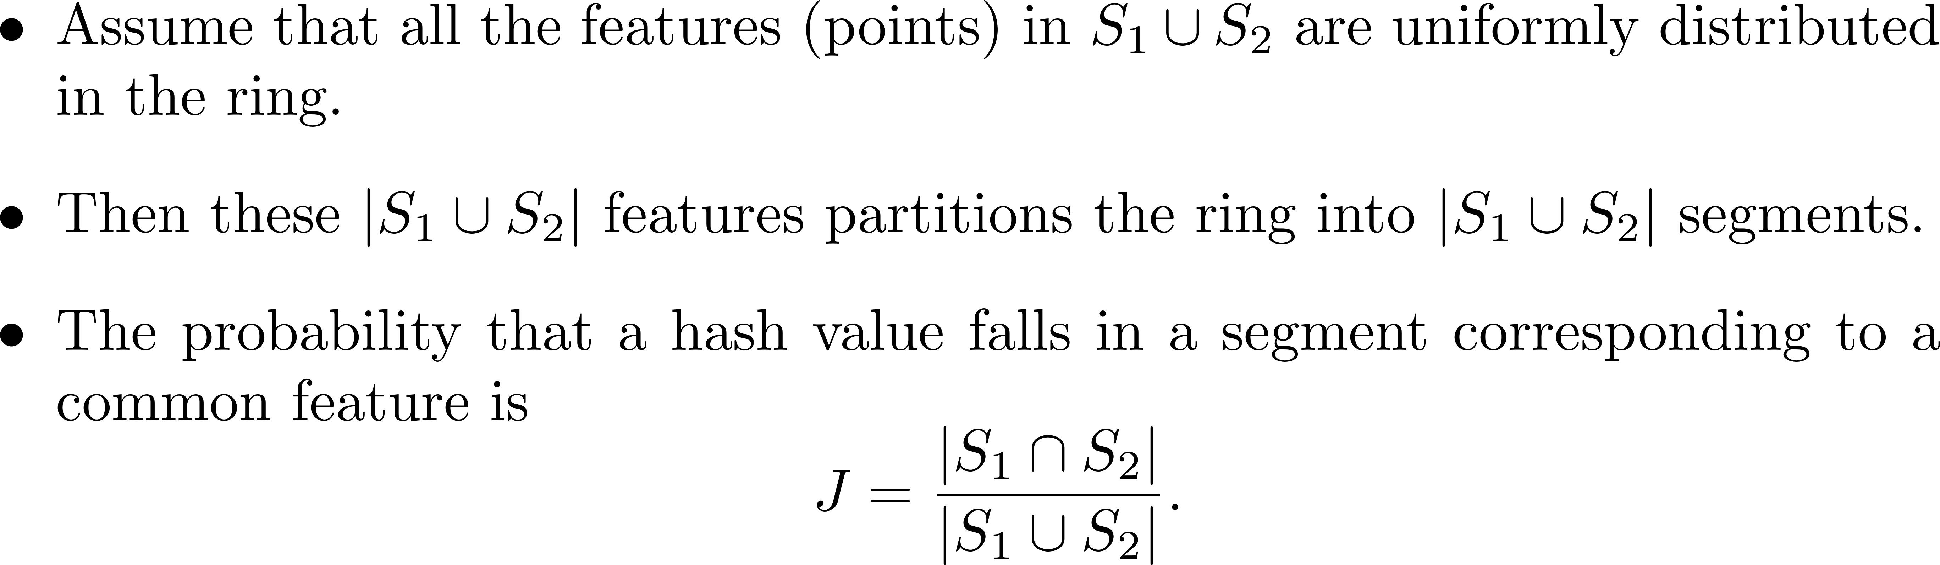

Slide 10
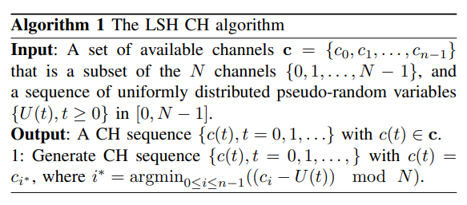

The sym/sync/hetero/global MRP
Channel hopping algorithm
Jaccard index:
Notes:
這是我們提出的LSH演算法，我等一下會用圖來說明這個演算法，就是在每一個時間點都用一個uniform hash function選一個channel，然後找到最近的available channel，然後根據剛剛的jaccard index的定義，我們可以把jaccard index寫成n1+n2-n12分之n12
This is LSH algorithm, I will explain it with a diagram later. Then, according to the definition of the jaccard index , we can write the jaccard index as n12/n1+n2-n12

Slide 11
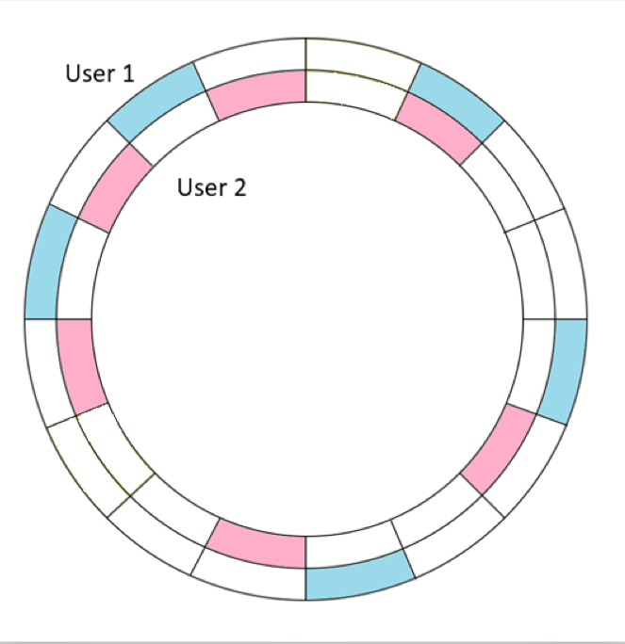
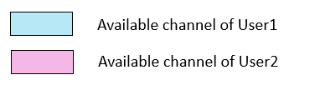
The synchronous setting
Channel hopping algorithm
Notes:
這是我們提出最簡單的lsh algorithm，這張圖代表兩個user，在外圍的user1，藍色的部分是user1的available channel，在裡面的是user2，粉紅色的部分是user2的 available channel，然後這個演算法就是在每一個時間點都uniform選一個channel，然後找對每一個user離的最近的available channel
Next, I’ll show the LSH algorithm by a diagram.
This picture represents two users. The user1 is the outer ring, the blue part is the available channel of user1, the inside ring is user2, and the pink part is the available channel of user2, and this algorithm is to select a channel uniformly at each time slot and then find the nearest available channel for each user.

Slide 12
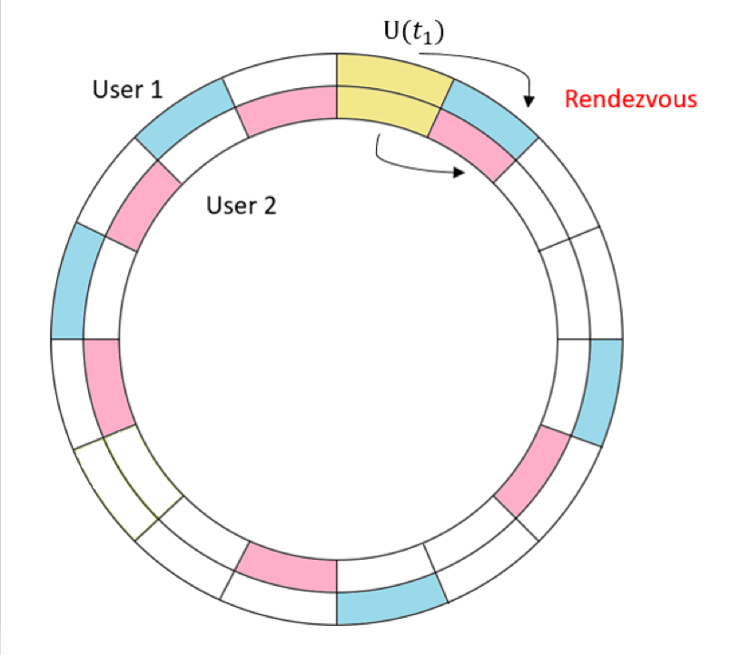
The synchronous setting
If we choose the yellow channel at t1
Notes:
如果在t1的時間選到這個yellow的channel，他會去找最近的available channel，然後就找到了common channel，這時候就rendezvous
If we choose the channel yellow and find the nearest available channel, the common channel was successfully found with LSH, then two user rendezvous.

Slide 13
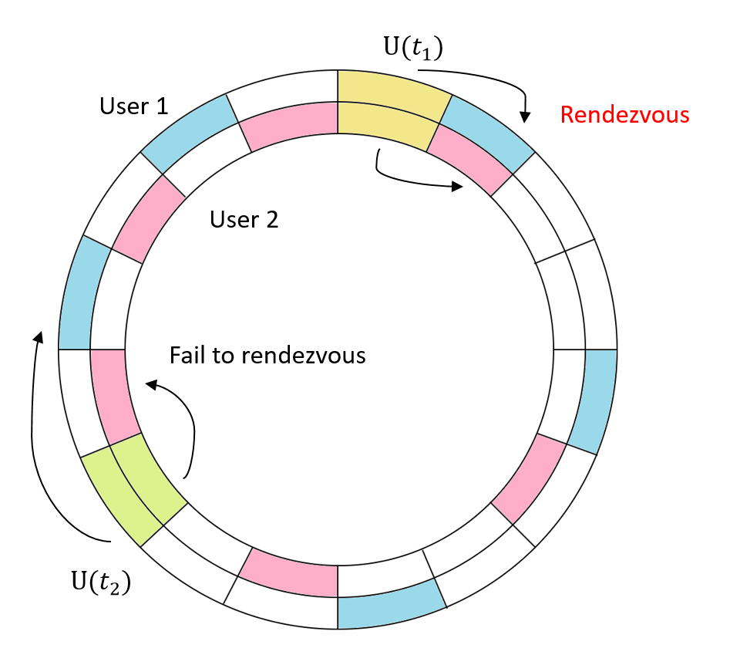
The synchronous setting
If we choose the green channel at t2
ETTR is close to 1/J
Notes:
如果在t2的時間選到這個綠色的channel，他會去找最近的available channel，然後就找到的channel不是common channel，這時候就rendezvous，然後我們用理論的證明證明出這個演算法的ETTR會接近1/J
If we choose green channel and use LSH algorithm to find available channel, the common channel will not be found, and it failed to rendezvous.
According to our theoretical derivation, ETTR of this algorithm is close to 1/J.

Slide 14
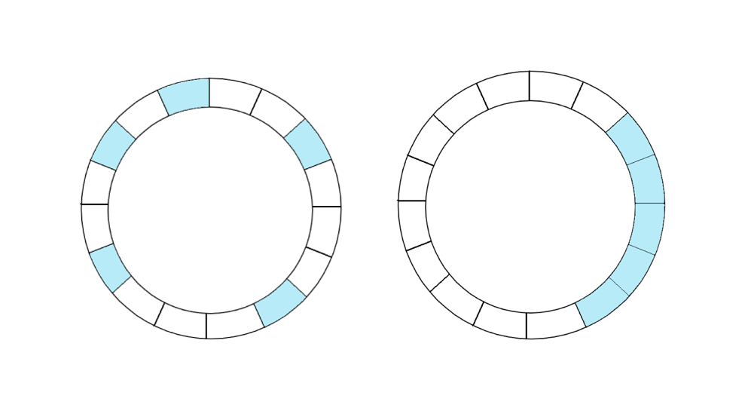
The synchronous setting
The drawback of LSH
ETTR of Algorithm 1 could sometimes be much larger than 1/J if available channels are not evenly distributed
-> remap channels
Method: Add a pseudo-random permutation π₁
Bad example
Evenly distributed
remap
Notes:
不過這個LSH有兩個缺點，第一個缺點就是如果available channel不是evenly distributed，就像這張圖畫出來的bad example，就是這些available channel是連續的，這樣會讓這個演算法的ETTR變大，不會像理論的j分之1，所以我們加上了一個pseudo random permutation，讓這些available channel變成是evenly distributed的。
However, LSH algorithm has two disadvantages. The first disadvantage is that if the available channels are not evenly distributed, like the bad example drawn in this picture, these available channels are contiguous, which will increase the ETTR of this algorithm. Therefore, we need to remap channels. so we added a pseudo random permutation to remap the channel and make these available channels evenly distributed.

Slide 15
The synchronous setting
The drawback of LSH
MTTR is not bounded because nothing is learned from a failed rendezvous attempt by using independent uniformly distributed random variables
-> To learn from a failed rendezvous attempt, one should use sampling without replacement
Method: replace the sequence of uniform hash functions by a pseudo-random permutation π₂ of the N channels
Notes:
另一個問題就是LSH的MTTR不會bound，因為他沒有從錯誤學習，可能會一直選到無法rendezvous的channel，所以我們這邊要用sampling without replacement，把原本的uniform hash function改成random permutation hash function，之後他的MTTR就可以bound到N
Another problem is that MTTR of LSH is not bounded because nothing is learned from a failed rendezvous attempt by using independent uniformly distributed random variables .
To learn from a failed rendezvous attempt one should use sampling without replacement.
So we change the original uniform hash function to random permutation hash function, and the MTTR can be bound to N

Slide 16
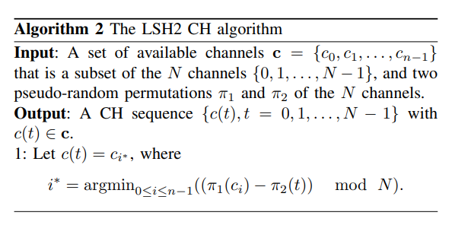
The synchronous setting
LSH2
Notes:
寫成演算法的話就是pi1(c)-pi2(t) 加上兩個random permutation變成LSH2這個演算法。
This algorithm is different from LSH. Change this function to two random permutations to become the algorithm of LSH2.
By changing this function to two random permutation, we can improve those two drawback.

Slide 17

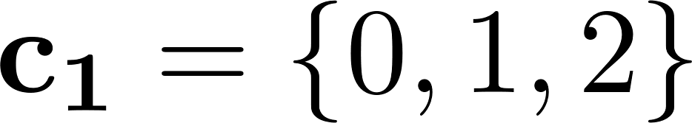
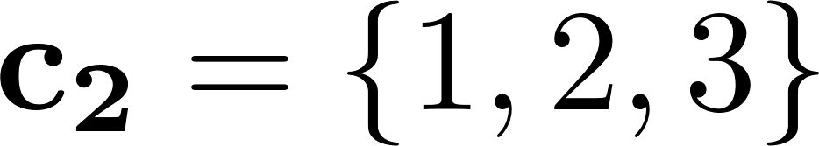
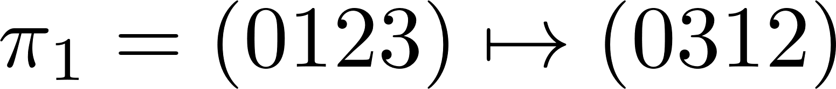
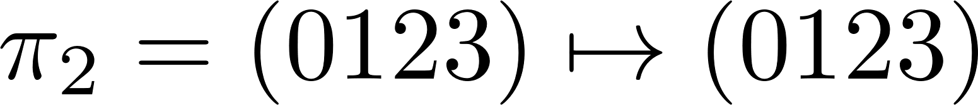
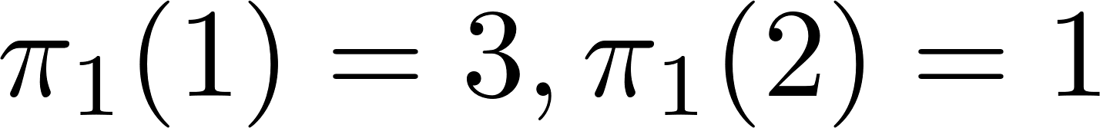


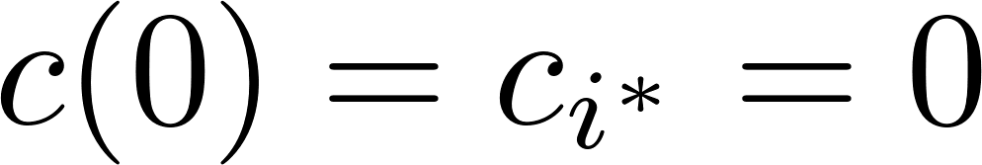

The synchronous setting
Example: Given and
If and
For user 1 , at .
We can compute
at . Therefore, for user 1.
0 | 2 | 1 | 1
CH sequence for User 1
0 | 2 | 1 | 1
1 | 1 | 2 | 0
CH sequence for User 2
2 | 2 | 3 | 1
Notes:
舉個例子

Slide 18

The synchronous setting
Consider the sym/sync/hetero/global MRP. Assume that the two users use the LSH2 algorithm to generate their CH sequences and that the two random permutations π₁ and π₂ are independent. Then the MTTR is bounded by N, and the ETTR approaches 1/J when N → ∞.
Notes:
這邊我們有證明一個theorem就是用LSH這個演算法的時候rendezvous的機率會是J，而且他的MTTR會bound到N，
我會介紹這個證明
We have proved that a theorem when using the LSH2 algorithm, the probability of rendezvous will be J, ETTR approach 1/J, and MTTR will be bound to N. More detailed proofs are in our paper.

Slide 19

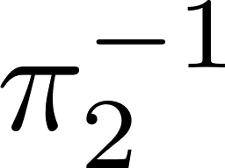


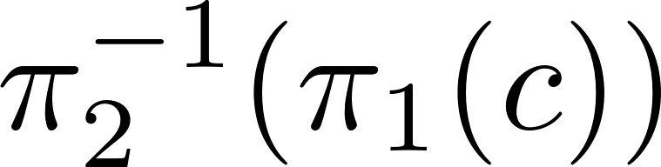
The synchronous setting
To show that the MTTR is bounded above by , let be the inverse permutation of Suppose that channel
is a common channel.
Then we have from the LSH2 algorithm that both users hop on channel at time
As such, the two users rendezvous within time slots.
Notes:
我們先證明MTTR會 bound到N，假設pi2是random permulation，這樣pi2-1就是inverse permutation，然後我們假設c是common channel，這樣子我們用LSH2會跳到channel c的時間就是pi2-1(pi c)，pi2每N個time slot就會在全部的channel重複一次，所以兩個user會在N個time slots之內rendezvous

Slide 20


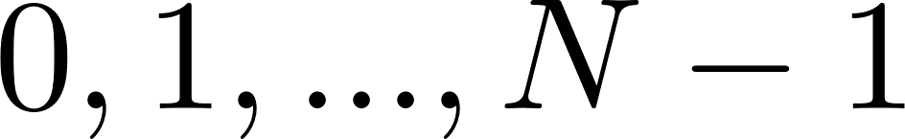

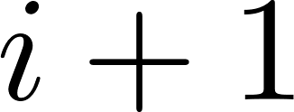
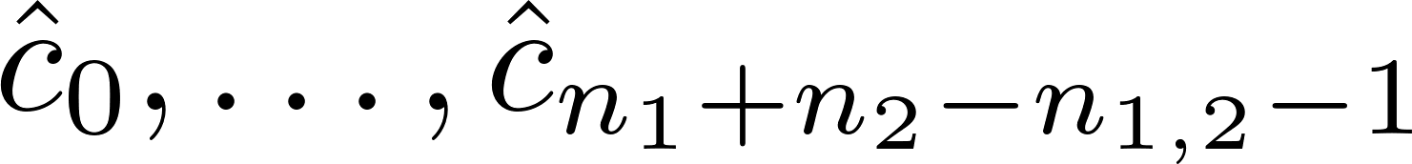
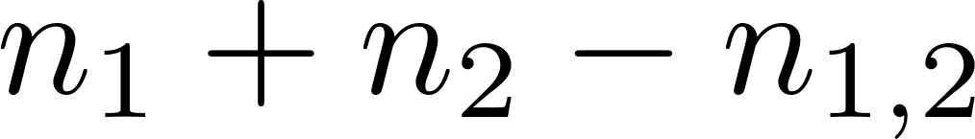

The synchronous setting
Let be the event that the two users hop to a common channel at time . We will show that
Let us consider a directed ring with N nodes, indexed from . In the ring, there is a directed edge from node to node mod . Let be the channels. Since is a random permutation , are randomly placed one by one (without replacement) into the ring.
Notes:
接下來我們要證明用這個演算法的ETTR是1/J，假設兩用戶在 time 跳到一個common channel。 然後我們的ring是有N個channel的ring。令n1+n2-n12是兩個user available channel的聯集。 然後我們會用pi1 remap channels
由於pi1是隨機排列，所以channel會被隨機地一個一個放入ring中。

Slide 21

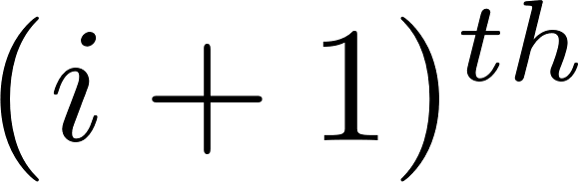



The synchronous setting
Let
Denote by be the smallest number in .
Now associate each node in the ring with the nearest neighbor (including itself) in , and this partitions the ring into line graphs. where the line graph contains nodes between node
and node
Notes:
假設B是user1跟user2有用到的channel，把沒有在user1跟user2用到的channel都partition到他最近有用到的channel，變成是一個一個的line graph

Slide 22
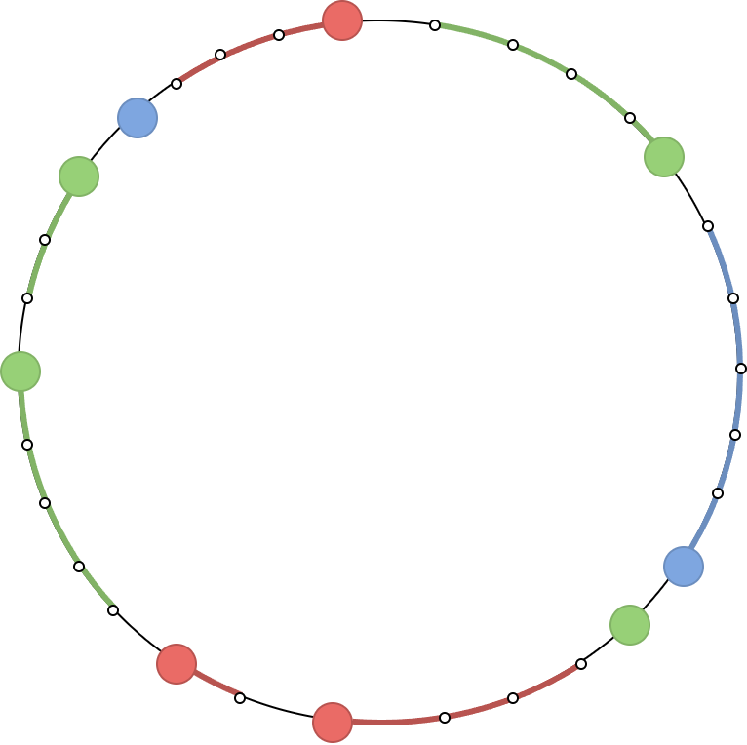
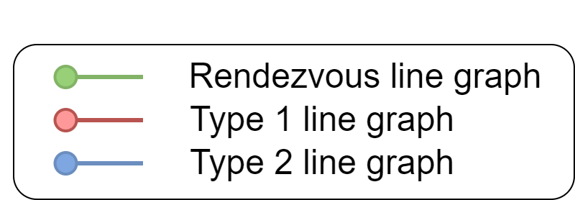
The synchronous setting
The illustration of line graph:
Notes:
那他就會變成這樣的line graph，那MTTR bound到N也可以用這個圖來說明，因為pi2是random permutation，所以在N之內它會在全部的channel都選過一遍，一定可以找到common channel

Slide 23
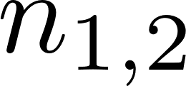
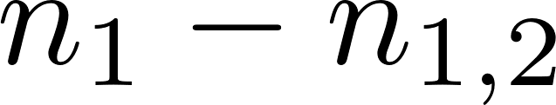
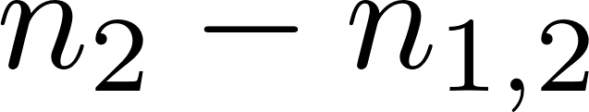
The synchronous setting
We classify the line graphs into three types:
Rendezvous line graph: the representing node is mapped from a common channel. There are rendezvous line graphs
Type 1 line graph: the representing node is mapped from an available channel of user 1 that is not a common channel. There are type 1 line graphs
Type 2 line graph: the representing node is mapped from an available channel of user 2 that is not a common channel. There are type 2 line graphs
Notes:
我們把所有的line graph分成三個type，第一種是rendezvous line graph，就是common channel，channel總共有n12個line graph，第二個是type 1 line graph，就是他是user1的available channel但不是common channel，總共有n1-n12個type 1 line graph，第三個是type 2 line graph就是他是user2的available channel但不是common channel，總共有n2-n12個type 1 line graph，

Slide 24

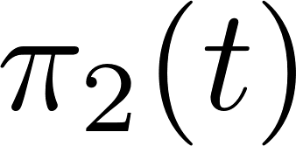

The synchronous setting
Let be the set of nodes in the rendezvous line graphs. According to Algorithm 2, the two users hop to a common channel at time t if and only if is a node in . Since , are randomly placed one by one into the ring, it follows from the symmetry of a random permutation that the numbers of nodes in the line graphs are identically distributed. Thus,
Notes:
這樣把沒有用到的channel都partition到最近的channel之後就可以把rendezvous的機率寫成B2的期望值，n12/n1+n2-n12，也就是J，然後ETTR就是這個機率的倒數1/J
In this way, after partitioning the unused channels to the nearest channel, the probability of rendezvous can be written into the expected value of the program B2, n12/n1+n2-n12, which is J

Slide 25




The synchronous setting
The illustration of line graph:
$$π_{2} (0)$$
$$π_{2}(1)$$
MTTR is bounded by N
$$π_{2}(3)$$
$$π_{2}(2)$$
Notes:
那他就會變成這樣的line graph，那MTTR bound到N也可以用這個圖來說明，因為pi2是random permutation，所以在N之內它會在全部的channel都選過一遍，一定可以找到common channel

Slide 26
The asynchronous setting
The sym/async/hetero/global MRP
The two users are indistinguishable.
Their clocks may not be synchronized.
Their available channel sets may differ
Each user's channel labels are globally labeled.

Slide 27
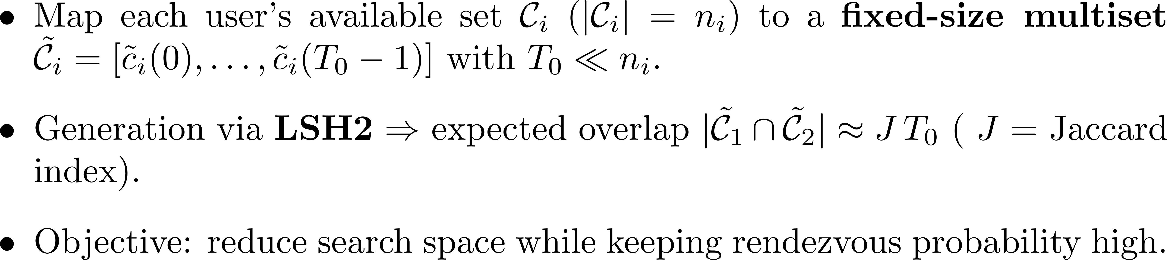
Dimensionality Reduction

Slide 28
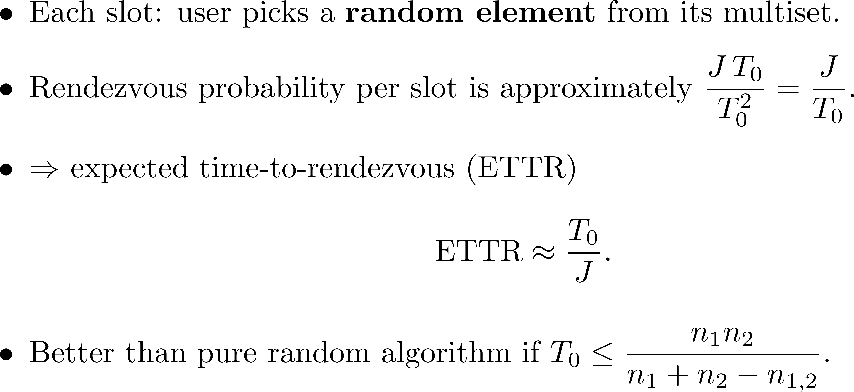
Random sampling from multisets

Slide 29
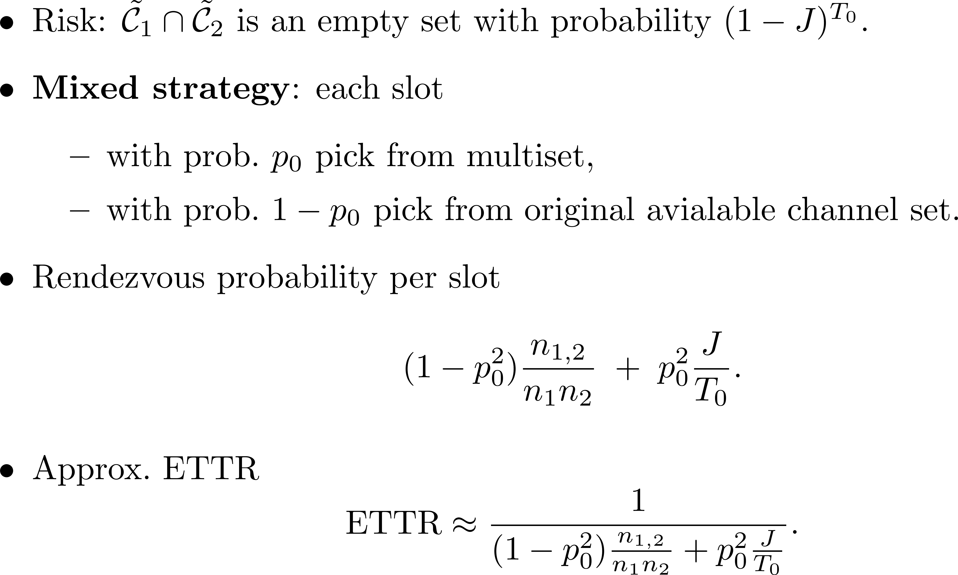
LSH4: Mitigating Empty-Intersection Risk

Slide 30
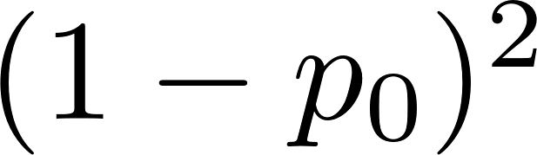
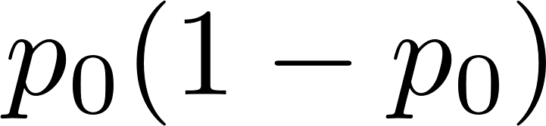
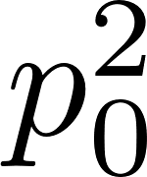
Approximation
Four cases
with probability , both users select their channels from the available channel sets
with probability , user 1 selects its channel from its multiset, and user 2 selects its channel from its available channel set
with probability , user 2 selects its channel from its multiset, and user 1 selects its channel from its available channel set
with probability , both users select their channels from the multisets
Notes:
Dimensionality reduction的部份我們也有做理論推導，不過因為都是dependent random variable所以會跟實際上的情況有誤差，就是一個approximation，這邊把它分成4個case，第一個case是兩個user都是從全部的available channel裡面選，機率是1-p0平方，然後第二個case是user1從multiset裡面選，user2從全部的available channel裡面選，機率是p0乘以(1-p0)，第三個case是user1從available channel裡面選，user2從multiset裡面選，第四個case是兩個都從multiset裡面選，然後前三個case機率都是random的所以我們之前有算過random選的機率是n1*n2分之n12，然後第四個case的機率是LSH的機率J再除以T0
Dimensionality reduction has also been theoretically deduced, but because they are all dependent random variables, there will be errors with the actual situation. It is an approximation. Here it is divided into 4 cases. The first case is that both users It is selected from all available channels, the probability is 1-p square, and then the second case is that user1 selects from the multiset, user2 selects from all available channels, the probability is p multiplied by (1-p), and the third case In the first case, user1 selects from the available channel, user2 selects from the multiset, the fourth case selects both from the multiset, and the probabilities of the first three cases are all random, so we have calculated the probability of random selection before. n1*n2/n12, then the probability of the fourth case is the probability J of LSH and divided by T0

Slide 31

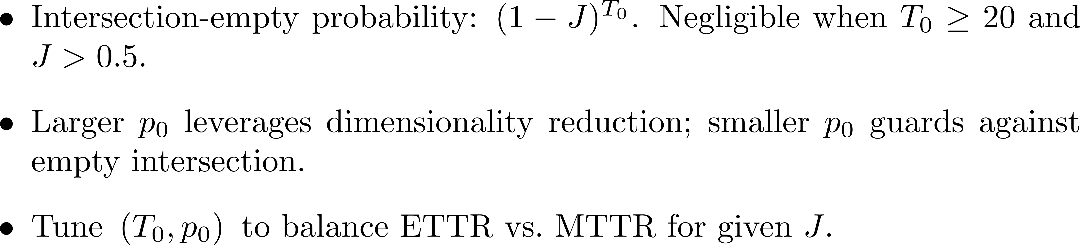

Slide 32
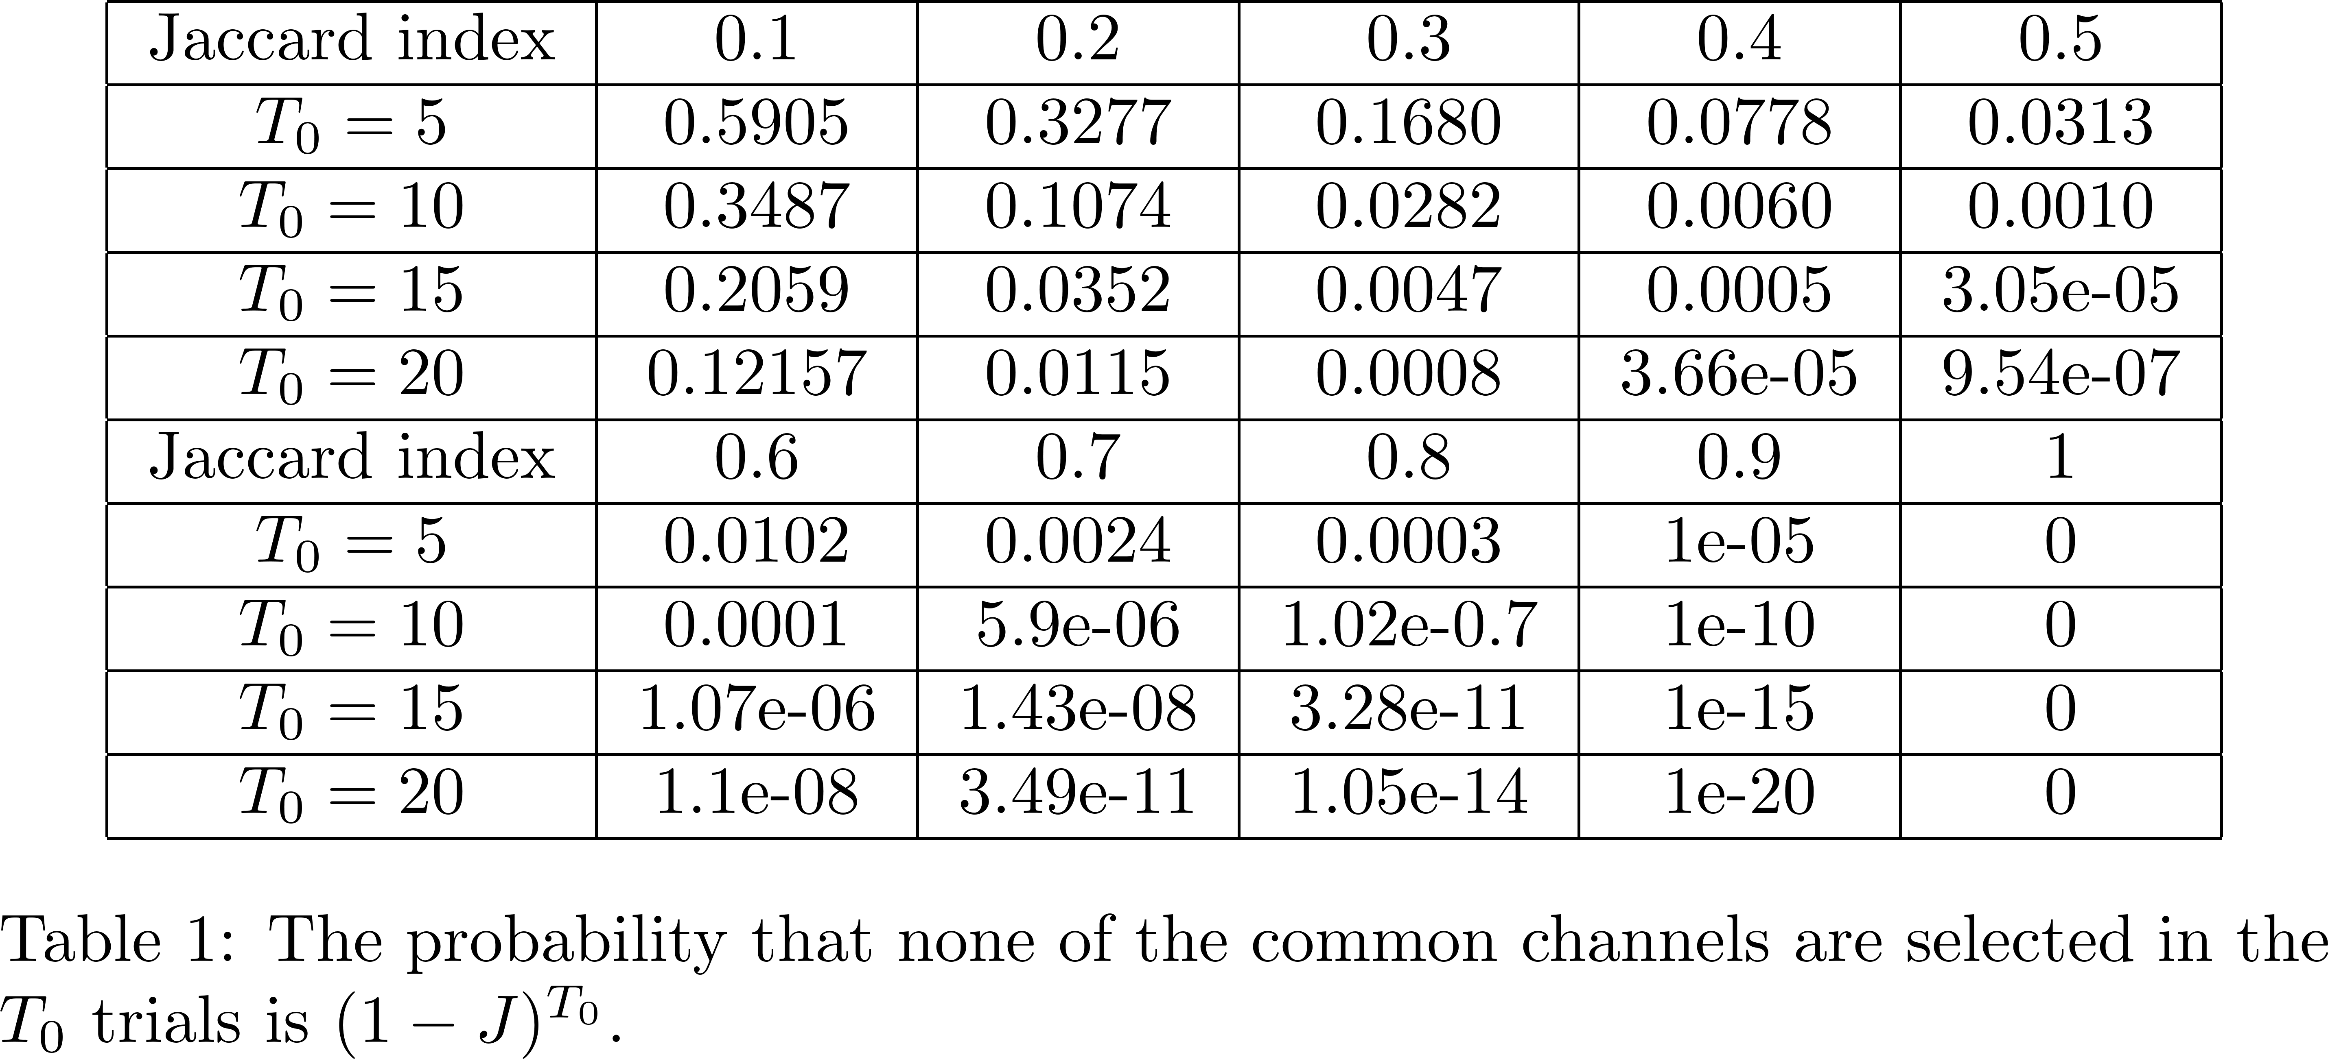

Slide 34
Why LSH4 is better than most existing algorithms in ETTR
Unlike the random algorithm and many existing algorithms in the literature, the channel hopping sequences generated by LSH4 for the two users are not independent.
This is because they are coupled by the two multisets generated by using the locality-sensitive hashing.
Such coupling improves the rendezvous probability, particularly when the Jaccard index is high.

Slide 35
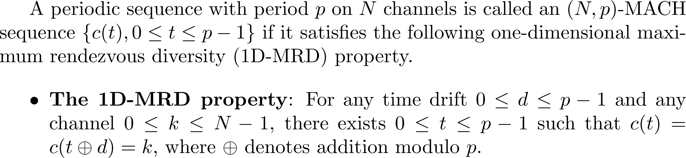
LSH with a bounded MTTR
Asynchronous Channel Hopping sequence with Maximum rendezvous diversity (MACH) sequence:
The idea is to embed LSH4 into an (N,p)-MACH.
Notes:
接下來我們在想剛才的方法那個sequence沒有MTTR的bound，但是我們還是希望這個sequence在理論上有一個bound，那要怎麼做呢，我們就把他跟MACH sequence座結合，這是MACH sequence的定義，他的全名是asynchronous channel hopping sequence with maximum rendezvous diversity
他的定義就是這個channel hopping sequence不管怎麼shift都會在一個周期內所有的channel至少都rendezvous過一次

Slide 36


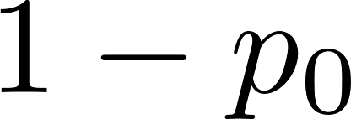
Embedding LSH4 into an (N,p)-MACH
MACH-LSH4
Use an existing MACH channel hopping sequence
Retain the available channels in the MACH channel hopping sequence.
Replace the other channels by the LSH4 algorithm.
With probability to randomly select a channel from the multiset.
With probability of to select a channel from the available channel set.
MACH-LSH4 still achieves rendezvous within the period p of MACH.
Notes:
我們利用現有的MACH sequence，然後如果是available channel的地方就保留在sequence裡面，如果沒有在available channel的話就用LSH4的方法取代他，這樣他就會有一個p 的MTTR bound，然後加入LSH4的部分可以降低ETTR

Slide 37
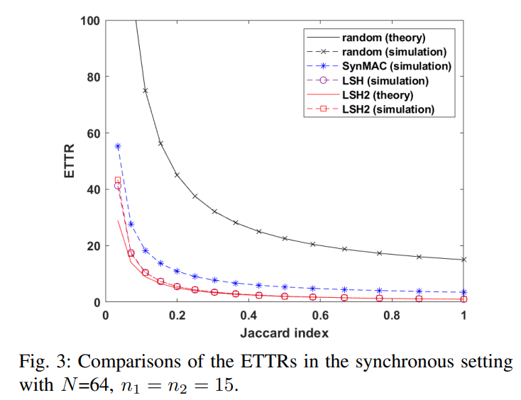
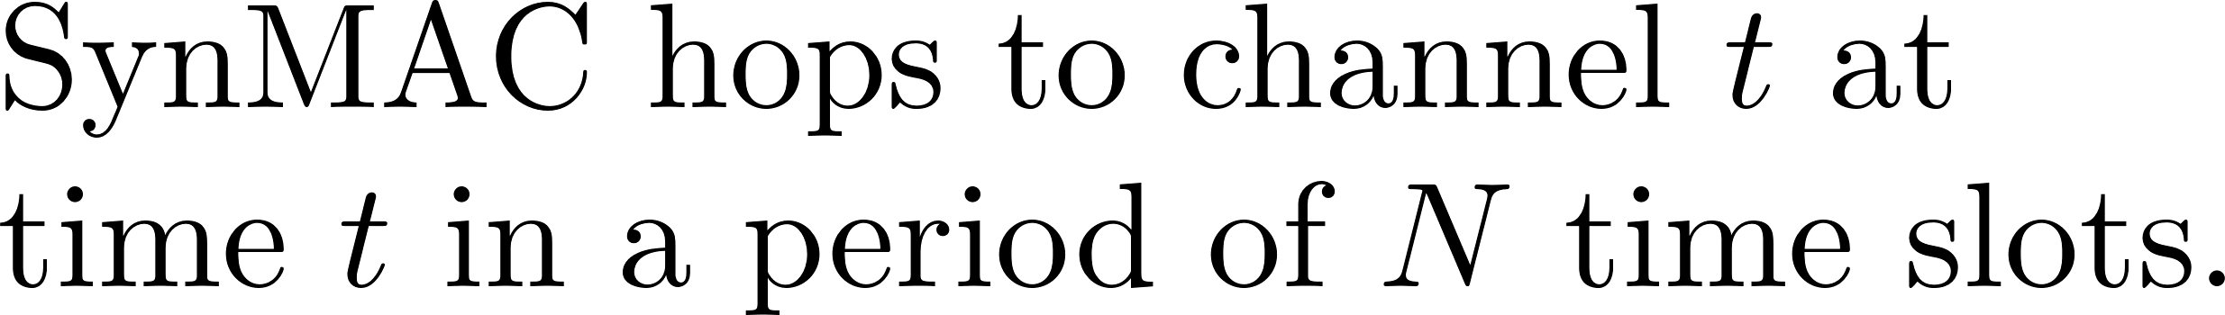
Simulation
Synchronous setting
The ETTR of LSH and LSH2 outperform SynMAC
Notes:
我們看到在synchronous的設定下做的實驗，知道在synchronous的情況下random 跟synmac是最好的，所以我們就把他跟random和synmac比較他的ETTR跟MTTR，可以看到ETTR的部分在N=64 n1=n2=15的情況下LSH跟LSH2非常接近，然後比synmac還有random好，然後跟理論值比較的話在jaccard index高的時候都很接近，但是在jaccard index低的情況下會有一些誤差
Next, I will show the simulation result of our algorithm. This is the experiment under the synchronous setting. We know that SymMAC is the best algorithm in the synchronous setting, so we compare its’ ETTR and MTTR with random and SymMAC. This is the simulation result under the synchronous setting with N=64 and n1=n2=15. The black line is the result of random algorithm, the blue line is SynMAC, the purple line is LSH, and the red line is LSH2. We can see that ETTR of LSH is very close to LSH2, and they are very close to the theoretical value, and it is better than SynMAC and random.

Slide 38
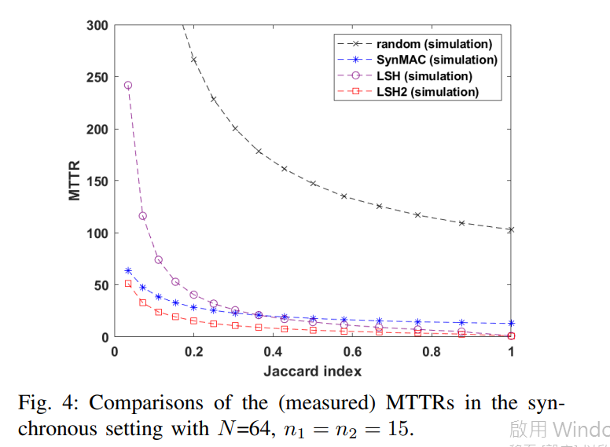
Simulation
Synchronous setting
The MTTR of LSH2 outperforms SynMAC
Notes:
Next, we compare simulated MTTR. The MTTR of LSH is not better than synMAC at lower jaccard index. And the MTTR of LSH2 outperform SynMAC at all range of Jaccard index.

Slide 39
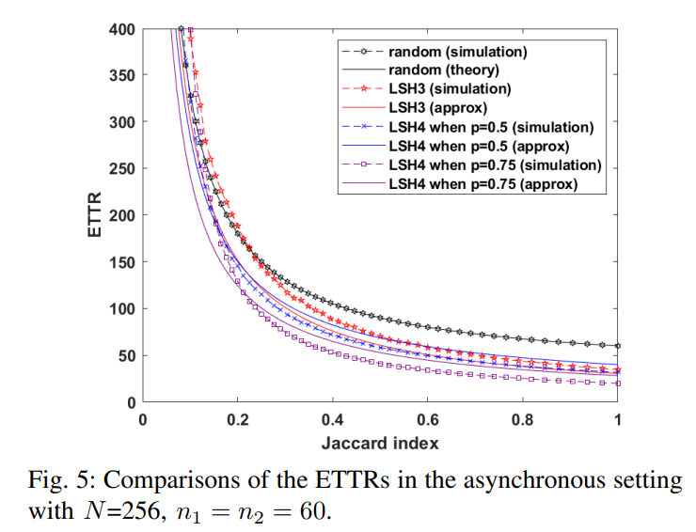
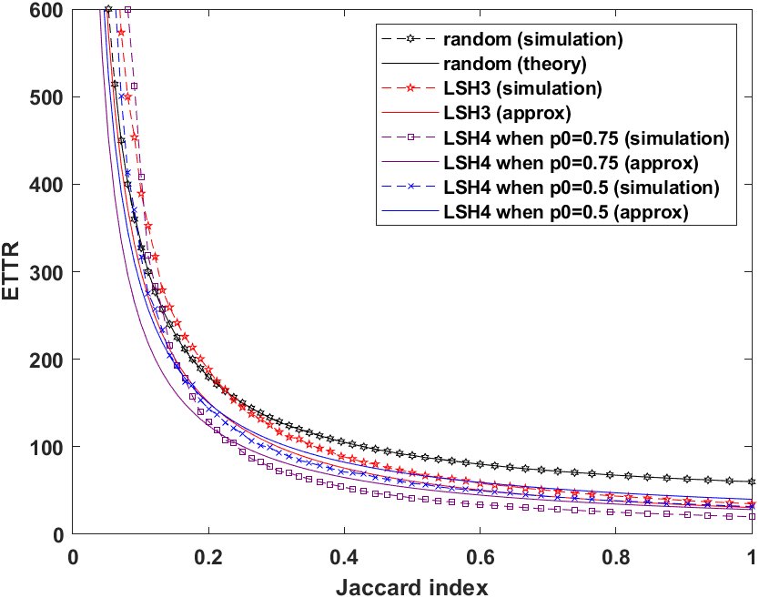

Simulation
Asynchronous setting
The ETTR of LSH3 and LSH4 outperform random when Jaccard Index is high ($J≥0.2$)
Notes:
接下來是asynchronous setting的時候的結過我們一樣去比較random跟LSH3還有LSH4，在以往的資料裡，雖然有一些作法在解決這個setting，不過他們都是用一些sequence確保MTTR的大小，而ETTR最好的還是random，然後我們的LSH這個算法在jaccard index超過0.32的時候就會比random的ETTR還要來的低，在jaccard index很小的地方會比random還要高，然後如果用我們改良的dimension reduction的方法就可以讓ETTR變得更小，在jaccard index大於0.2的地方也會比random還要好。
Next I’ll show the result of the asynchronous setting with N=256 and n1=n2=60. The black line is the simulation result of random. The ETTR of other existing methods is worse than random, so we only compare our algorithm with the random algorithm here. The red line is the result of LSH3, the blue line is the result of LSH4 at p=0.5, and the purple line is the result of LSH4 at p=0.75.
The ETTR of LSH3 and LSH4 outperform random when Jaccard index is higher than 0.2(J >=0.2)

Slide 40
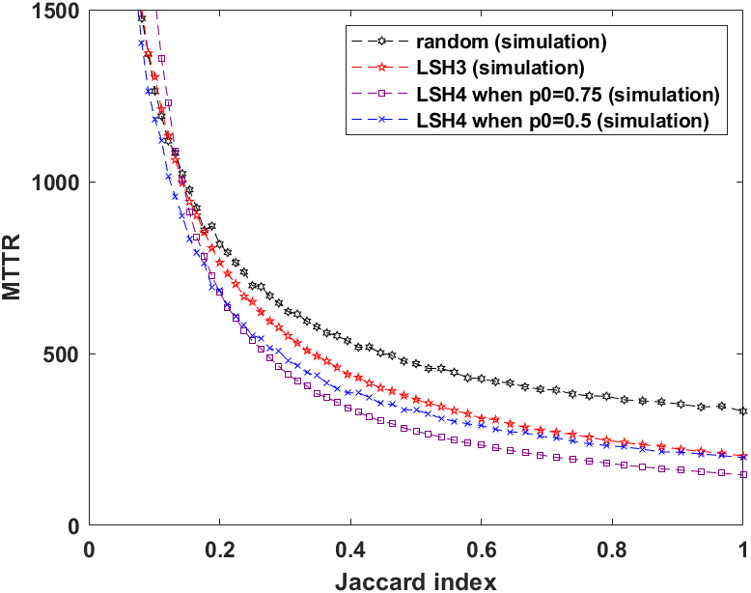
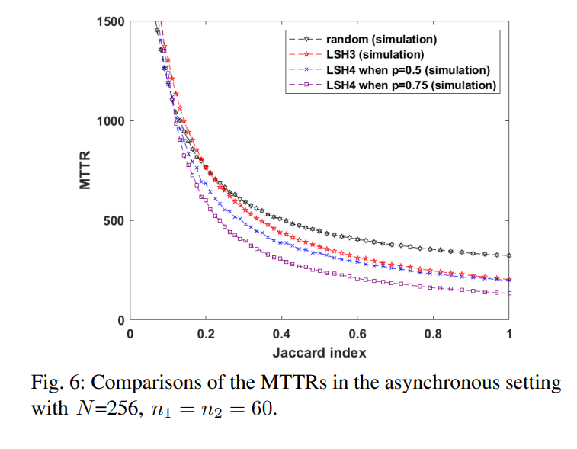

Simulation
Asynchronous setting
The MTTR of LSH3 and LSH4 outperform random when Jaccard Index is high ($J≥0.2$)
Notes:
這邊是比較MTTR的部分，可以看到模擬的結果MTTR是有比random還要好，不過在理論上LSH3跟LSH4事沒有upper bound的
Here is the part comparing simulative MTTR. You can see that the simulation result.
The MTTR of LSH3 and LSH4 is lower than random when Jaccard Index is higher than 0.2 ($J≥0.2$)

Slide 41

Simulation in the asynchronous setting
Embedding LSH4 in an (N,p)-MACH
Notes:
這邊是我們剛剛提出的embed to periodic sequence的演算法MACHLSH4的結果，我們分別把她embed 到DRDS CRSEQ跟TCH這幾個channel hopping sequence，我們可以發現在ETTR的部分在同樣的p跟T0的情況下CRSEQLSH4跟TCHLSH4的結果在幾乎整條jaccard index的線都比random還要好，DRDSLSH4的結果比較差一點，這跟那個channel hopping sequence本身的結構有關係，我們可以選擇結果較好的來應用在實際情況上

Slide 42

Simulation
LSH with a bounded MTTR
Notes:
這是比較MTTR的結果，一樣可以發現在jaccard index大於0.3的情況下CRSEQLSH4跟TCHLSH4的情況simulation的結果都比random還要好，不過我們用這個演算法主要是想保證理論上的MTTR bound，然後因為我們用random選一直選不到的機率非常低，所以再jaccard index低的地方無法用simulation的方式顯示出他真正的MTTR bound，但是事實上random這個方法是沒有bound的，所以我們的方法還是有他的貢獻

